Slide 1
To Do List Project
Bernard Abraham

Slide 2
Consultant Journey
Week 1,2,3,4,5,6,7 things we learned that were implemented
Skills ive learned

Slide 3
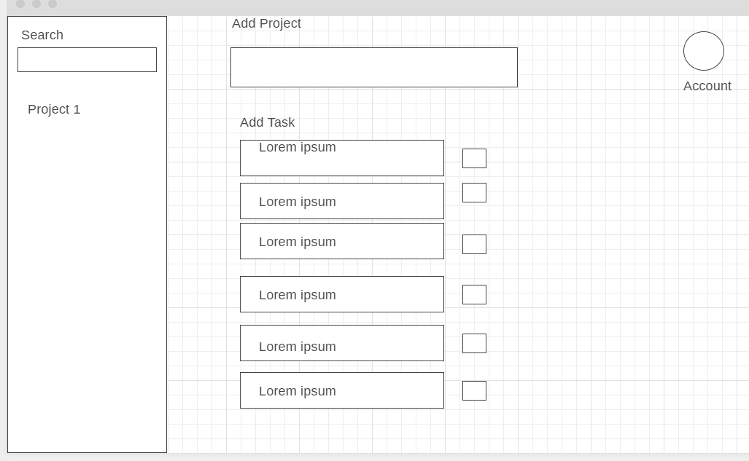
Wireframes
Add tasks as part of a project
Check tasks off
Search Tasks
Manage Account

Slide 4
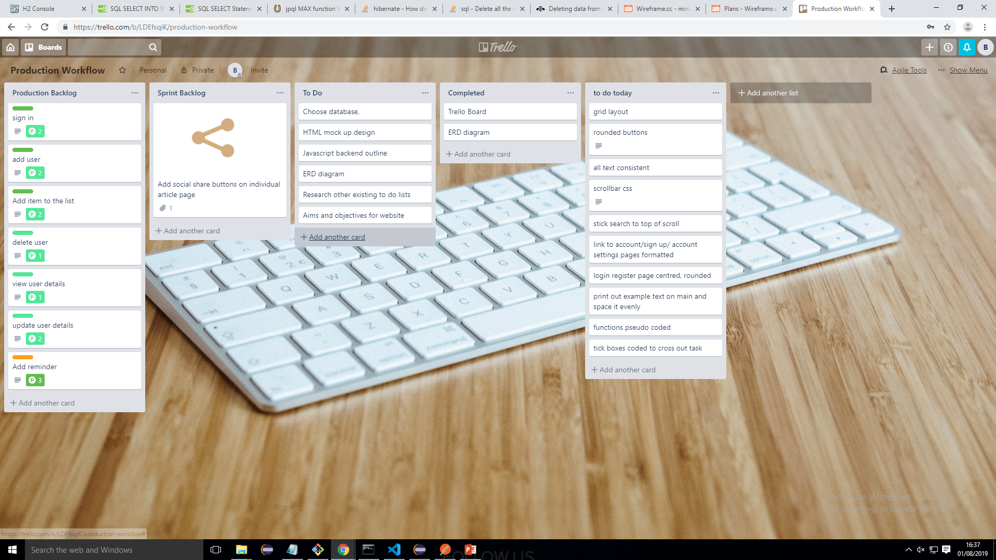
Trello Before

Slide 5
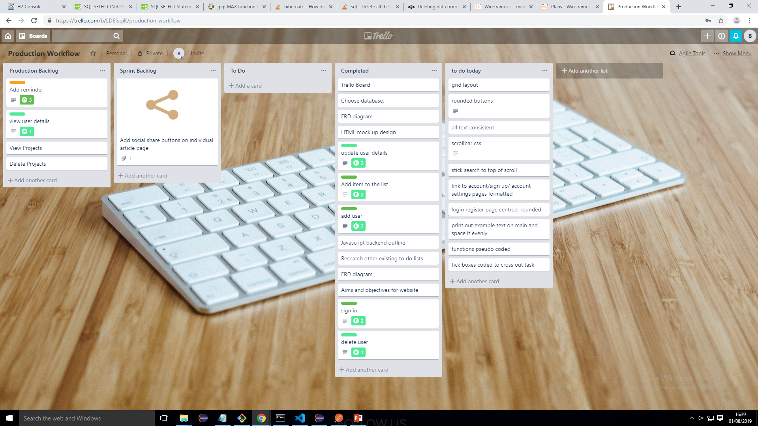
Trello After

Slide 6
Database - Erd Diagram
Task
Task
Project
User
Pkey - TaskId
Pkey - ProjectId
Pkey - UserId
Fkey - ProjectId
Fkey - UserId

Slide 7








Technologies
Describe how these work together, what ones I've used, how I can use them all next time

Slide 8
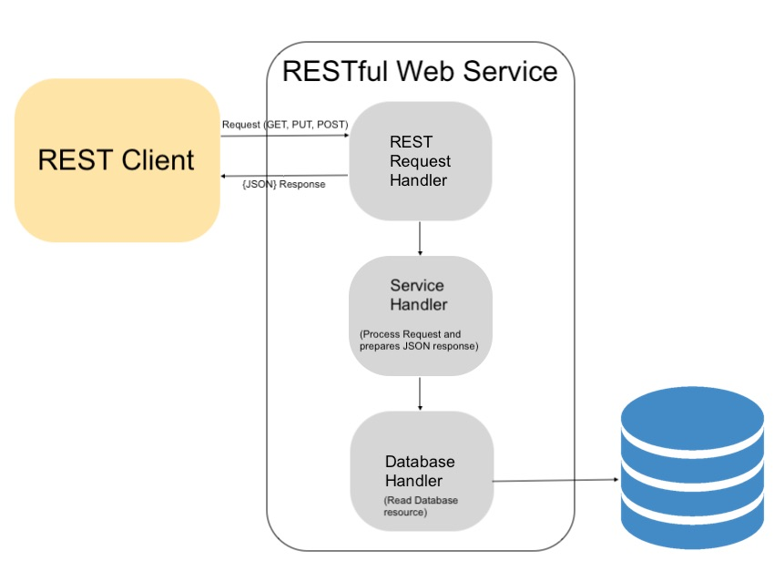
API
Service layer (front-end)
Rest (controller and endpoints)
Logic (services)
Data Access (repository and classes entity manager)
Sql h2

Slide 9
Screenshots
Users
Adding tasks
Registering

Slide 10
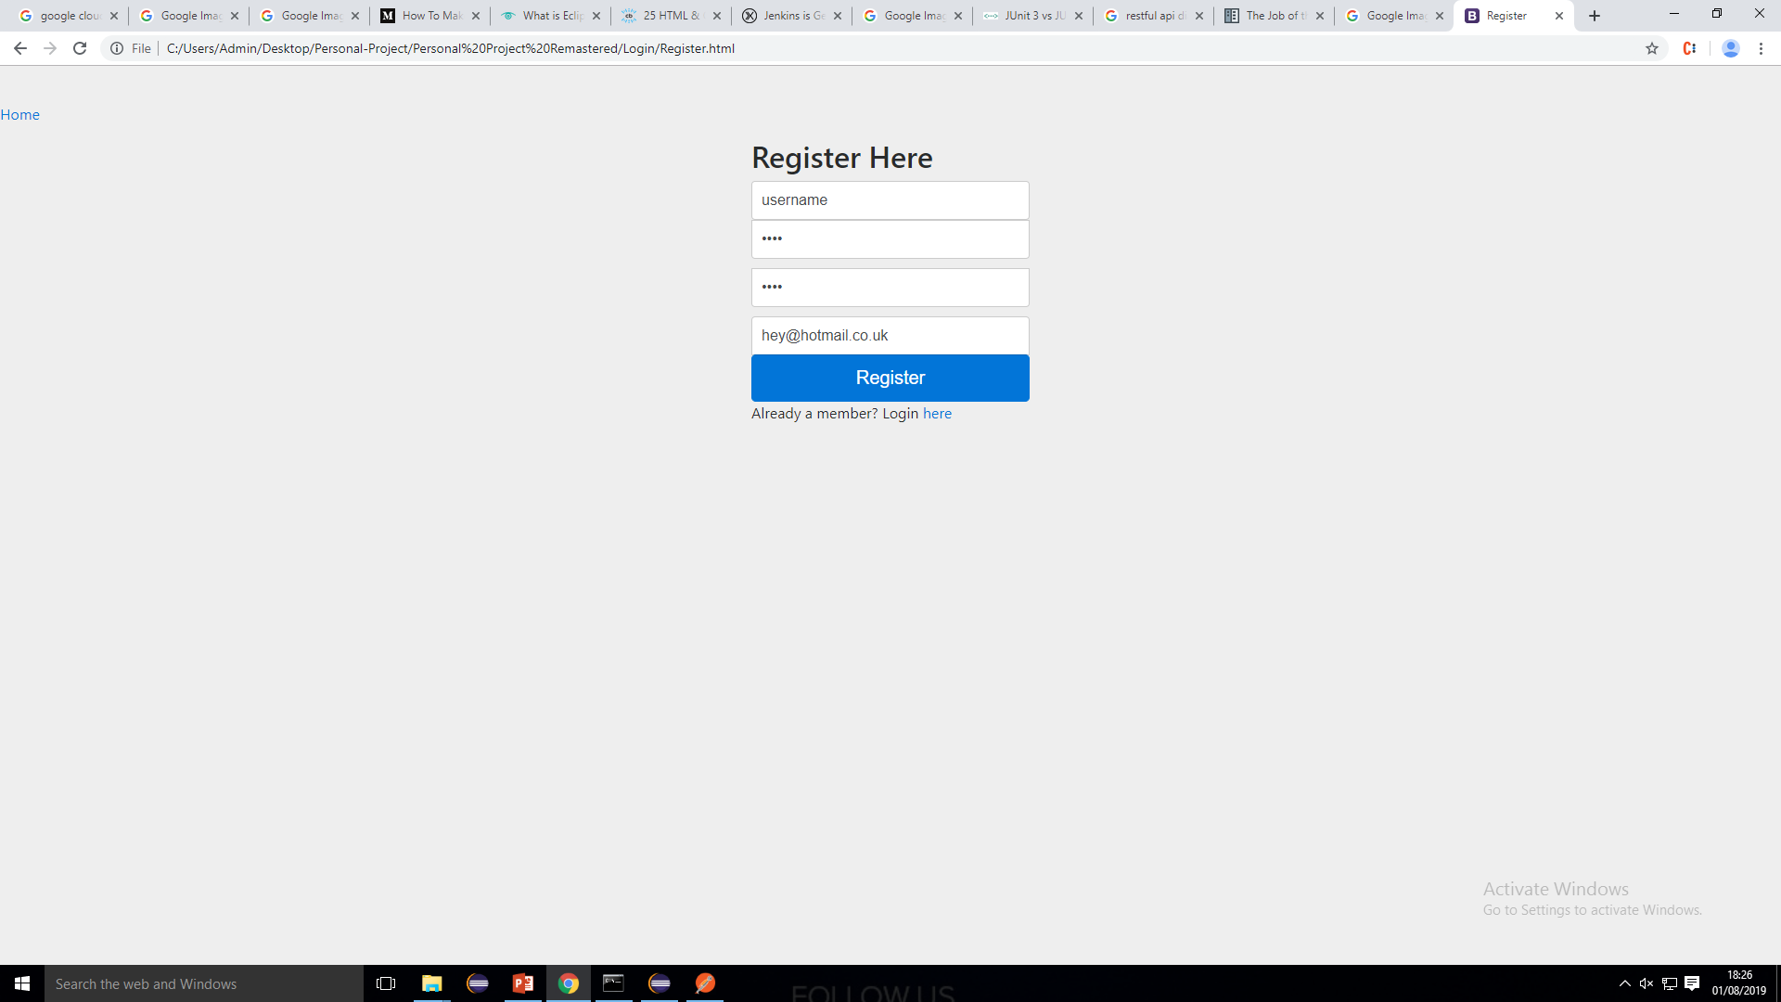

Slide 11
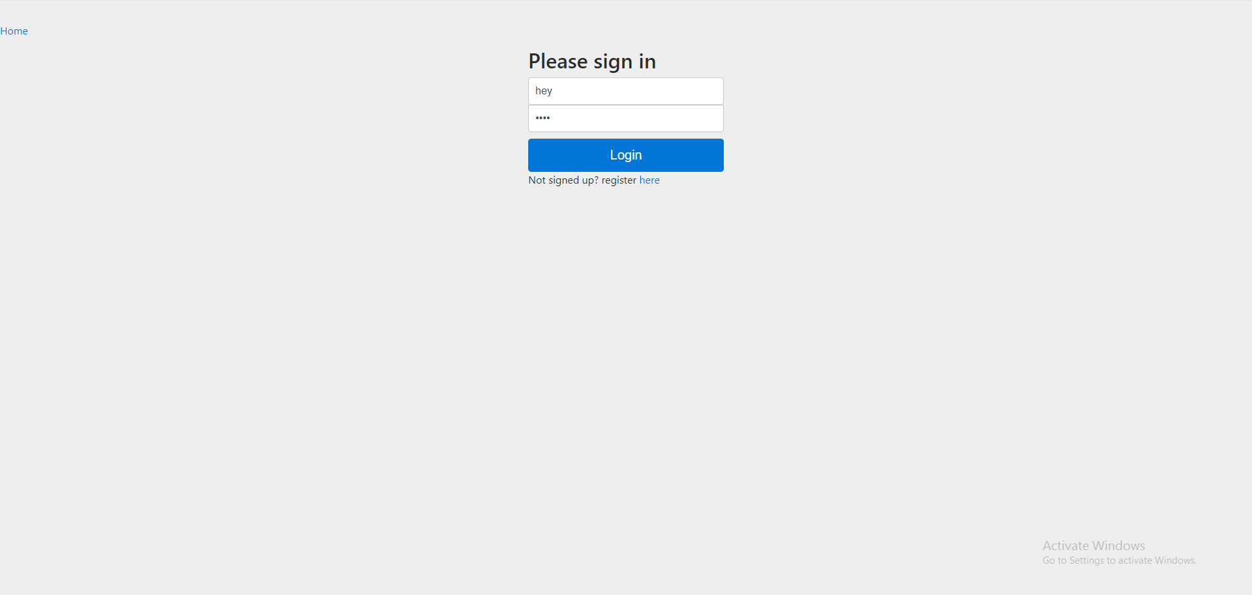

Slide 12
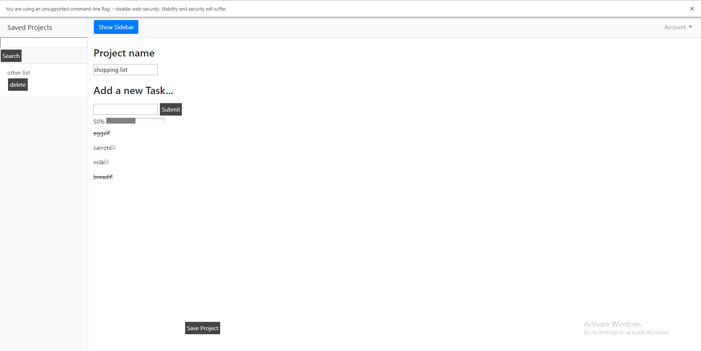

Slide 13
Project Summary
What went well
3 Tables with Relationships
Multiple pages
Login functionality
Extra features
What could be Improved, how I’d do it differently
Th
Th
Th
Th
Th
Th

Slide 14
Project Walkthrough
Live demonstration

Slide 15
Thankyou for listening
Questions?

